Slide 1

Orthopedic walker fall detection
Activity Logging Using Motion Classification

Slide 2

Team-3
V. Abhinav
AM.EN.U4CSE21060
V. Naga Varnika
AM.EN.U4CSE21059
Ch. Harshitha
AM.EN.U4CSE21018

Slide 3
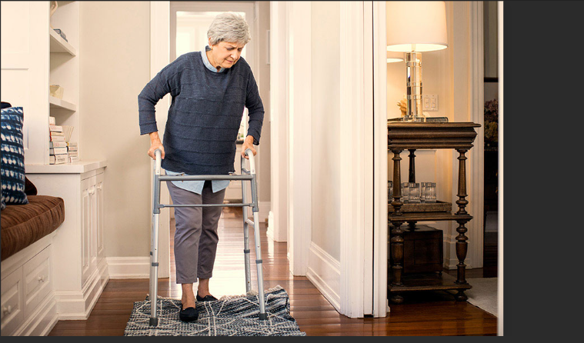

Problem Statement
Fall incidents among elderly individuals and patients with limited mobility who rely on orthopedic walkers pose a significant risk to their safety and well-being.

Slide 4

Datasets

Slide 5
The Dataset for the project is taken from Kaggle
The actual data is taken from the sensors on orthopedic walkers, wearable devices, and a combination of sources.
Walker Fall Detection Dataset (kaggle.com)
Data Source

Slide 6
Accelerometer Features (acc):
acc_x_0 to acc_x_8: Accelerometer readings along the X-axis.
acc_y_0 to acc_y_8: Accelerometer readings along the Y-axis.
Gyroscope Features (gy):
gy_x_0 to gy_x_159: Gyroscope readings along the X-axis.
gy_y_0 to gy_y_159: Gyroscope readings along the Y-axis.
Label:
The target variable.
Features

Slide 7
The falls are Labelled as:
Idle: Represents periods of no movement, indicating that the walker is stationary.
Step: Capture moments when an individual takes a step using the walker.
Movement: Covers any movement that is not considered a step or a fall, such as when carrying the walker or adjusting its position.
Fall: Denotes cases in which the walker tips over and falls to the ground from an upright position.
Labelling

Slide 8
Data Volume
Data Quality
The dataset has 961 columns, with the first column being 'label' and the rest being sensor readings.
The sensor readings are likely from three axes (X, Y, and Z) for both accelerometer (acc) and gyroscope (gy).
The numerical values in these columns represent the sensor readings over time.
Missing Values:
Simple Mean Imputer is used.
Outliers:
Z-score handling is used.
Duplicates:
Duplicates are dropped.

Slide 9
Models
Used

Slide 10
Extra Trees (Extremely Randomized Trees) is an ensemble learning method that builds multiple decision trees during training and merges them together for more robust predictions.
Unlike traditional Random Forests, Extra Trees not only bootstrap samples but also randomly select features at each split point in the trees. This adds an extra layer of randomness, making it more resistant to overfitting.
Extra Trees aims to strike a balance between bias and variance. By introducing additional randomness, it often reduces overfitting, making it suitable for various types of datasets.
Extra Trees can be computationally more efficient than Random Forests because it requires fewer computations to find the optimal split at each node due to the random feature selection.
Extra Trees

Slide 11
Random Forest is an ensemble learning method that builds multiple decision trees during training and merges them together to get a more accurate and stable prediction.
Random Forest employs bootstrap sampling, meaning that each tree is trained on a random subset of the original dataset with replacement. This introduces diversity among the trees.
At each split in the tree, Random Forest considers a random subset of features for making the split decision. This helps decorrelate the trees and avoid overfitting.
The combination of bootstrap sampling and feature randomness helps reduce the variance of the model, making Random Forest less prone to overfitting compared to individual decision trees.
Random
Forest

Slide 12
Support Vector Machines(SVM) is a powerful algorithm for binary classification tasks, making it suitable for scenarios where the goal is to classify instances into "fall" or "non-fall" categories.
SVM aims to find a hyperplane that maximizes the margin between different classes. This can contribute to better generalization performance on unseen data.
SVM can efficiently handle non-linear decision boundaries through the use of kernel functions, such as the radial basis function (RBF) kernel. This allows SVM to capture complex relationships in the data.
SVM can handle high-dimensional data, which is beneficial if your fall detection dataset contains a large number of features or sensor inputs.
SVM

Slide 13
Result & Analysis

Slide 14
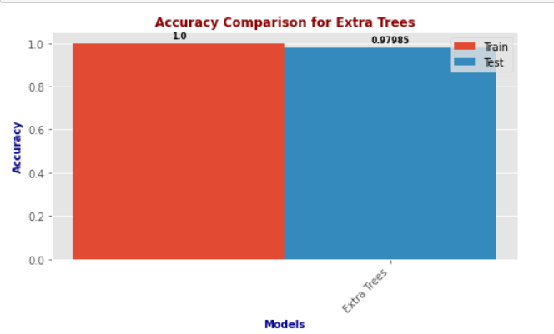
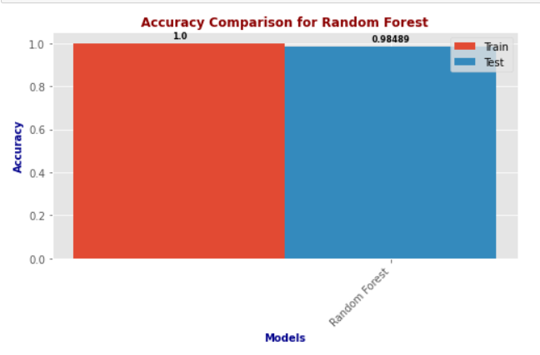
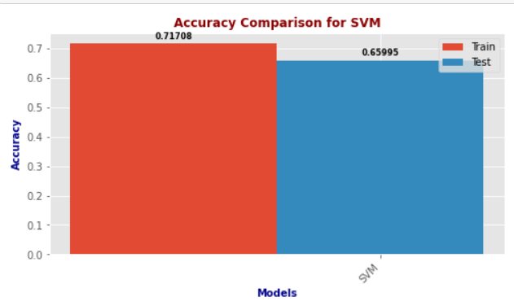
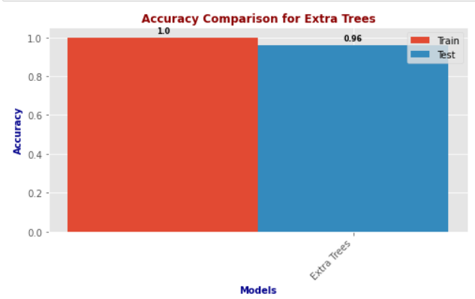
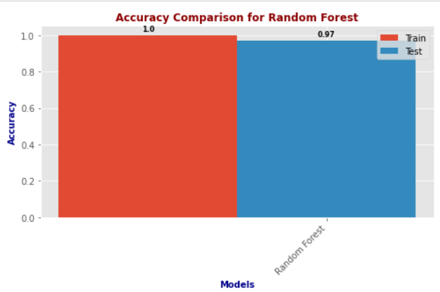
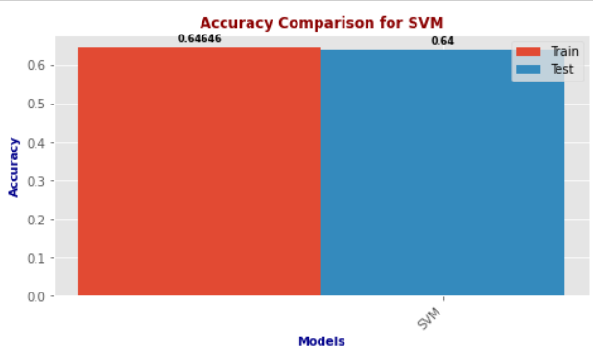
Accuracies
Dataset-1
Dataset-2

Slide 15
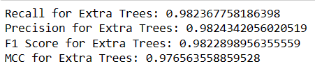
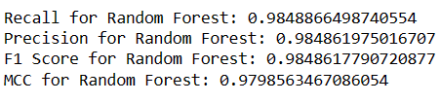
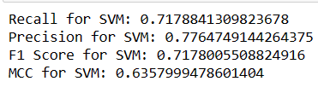
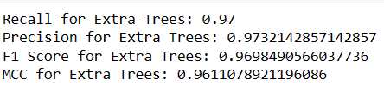
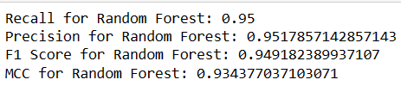
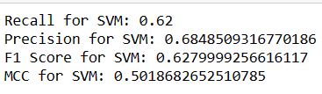

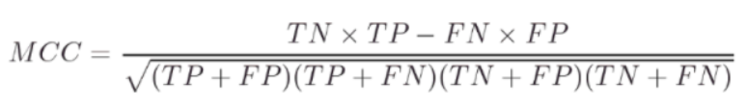

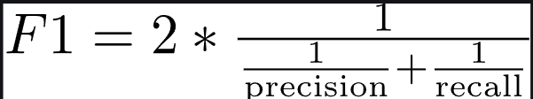
Dataset-1
Dataset-2
Performance
Metrics

Slide 16
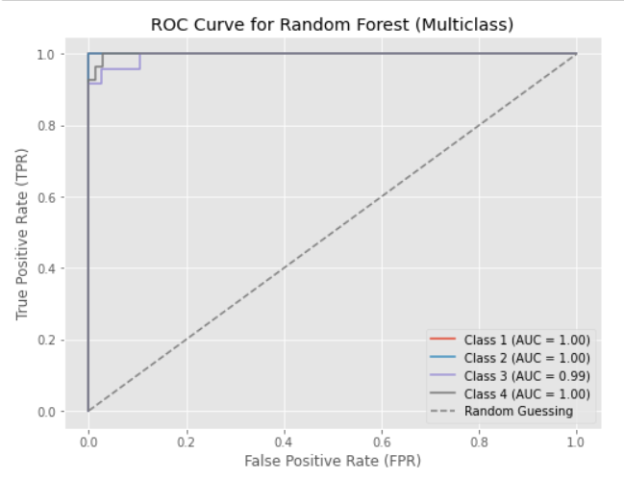
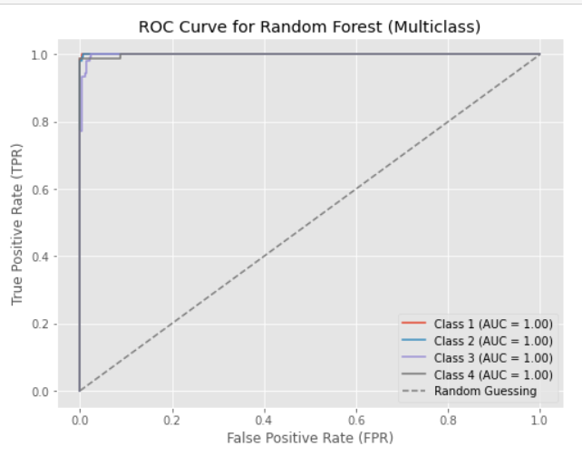
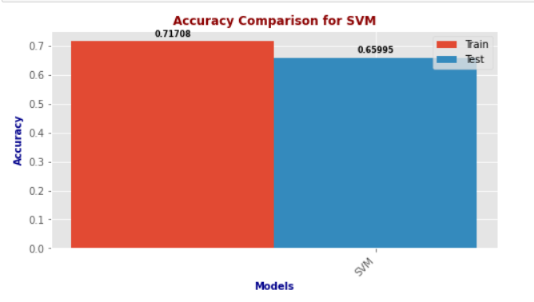
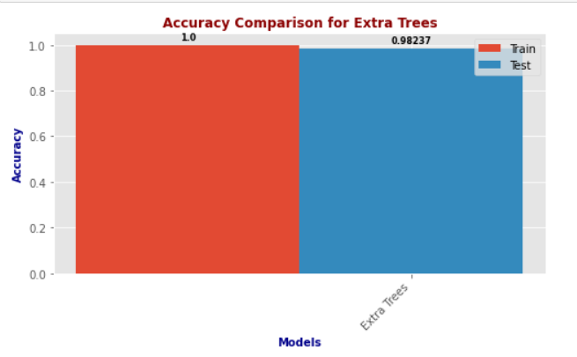
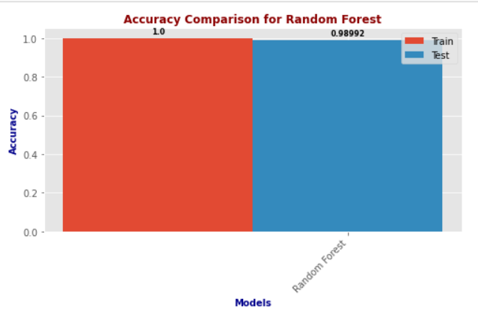
ROC curves
Dataset-2
Dataset-1
The ROC curve in this image indicates that the Random Forest model has performed exceptionally well for all four classes, as evidenced by each class having an Area Under Curve (AUC) of 1.00. This means the model has a perfect true positive rate and a zero false positive rate for each class, indicating excellent classification performance.
Some insights that can be derived from this ROC curve are:
The Random Forest model is better than random guessing for all four classes, as all the class curves are above the diagonal line.
The Random Forest model is most effective for Class 1, Class 2, Class 3, and Class 4, as they have the highest TPR and the lowest FPR for any threshold. This means that the model can correctly identify most of the instances of these classes and avoid misclassifying other classes as these classes.
The Random Forest model does not have any trade-off between sensitivity and specificity, as it achieves both at the highest level possible. This means that the model does not sacrifice accuracy for any class to improve accuracy for another class.
The ROC curve in the image shows that the Random Forest model has performed exceptionally well for multiclass classification. All classes except Class 3 have a perfect Area Under Curve (AUC) of 1.00, indicating excellent model performance with maximum true positive rate and minimal false positive rate. Class 3 has an AUC of 0.99, which is still very good.
Some insights that can be derived from this ROC curve are:
The Random Forest model is better than random guessing for all four classes, as all the class curves are above the diagonal line.
The Random Forest model is most effective for Class 1, Class 2, and Class 4, as they have the highest TPR and the lowest FPR for any threshold. This means that the model can correctly identify most of the instances of these classes and avoid misclassifying other classes as these classes.
The Random Forest model is slightly less effective for Class 3, as it has a lower TPR and a higher FPR than the other classes for some thresholds. This means that the model may miss some of the instances of Class 3 or misclassify some other classes as Class 3. However, the difference is not very significant and the model still has a high AUC of 0.99.

Slide 17

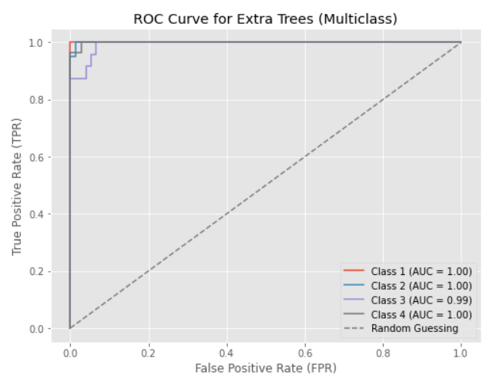
Dataset-1
Dataset-2
ROC curves
The ROC curve in the image shows that the Extra Trees classifier has performed exceptionally well for all four classes, as indicated by an AUC (Area Under Curve) of 1.00 for each class. This means that the model has a perfect true positive rate and a zero false positive rate, indicating excellent performance in distinguishing between the different classes.
Some insights that can be derived from this ROC curve are:
The Extra Trees model is better than random guessing for all four classes, as all the class curves are above the diagonal line.
The Extra Trees model is most effective for Class 1, Class 2, Class 3, and Class 4, as they have the highest TPR and the lowest FPR for any threshold. This means that the model can correctly identify most of the instances of these classes and avoid misclassifying other classes as these classes.
The Extra Trees model does not have any trade-off between sensitivity and specificity, as it achieves both at the highest level possible. This means that the model does not sacrifice accuracy for any class to improve accuracy for another class.
The ROC curve in the image shows that the Extra Trees classifier has performed exceptionally well for multiclass classification. All classes except Class 3 have a perfect Area Under Curve (AUC) of 1.00, indicating excellent model performance with maximum true positive rate and minimal false positive rate. Class 3 has an AUC of 0.99, which is still considered excellent.
Some insights that can be derived from this ROC curve are:
The Extra Trees model is better than random guessing for all four classes, as all the class curves are above the diagonal line.
The Extra Trees model is most effective for Class 1, Class 2, and Class 4, as they have the highest TPR and the lowest FPR for any threshold. This means that the model can correctly identify most of the instances of these classes and avoid misclassifying other classes as these classes.
The Extra Trees model is slightly less effective for Class 3, as it has a lower TPR and a higher FPR than the other classes for some thresholds. This means that the model may miss some of the instances of Class 3 or misclassify some other classes as Class 3. However, the difference is not very significant and the model still has a high AUC of 0.99.

Slide 18
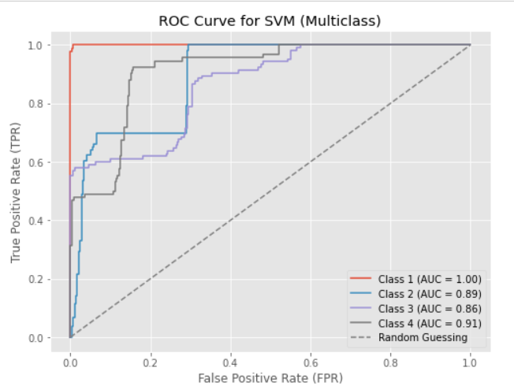
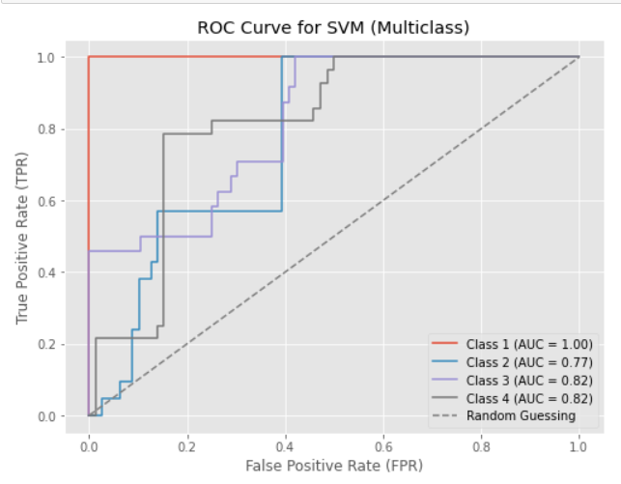
The ROC curve in the image is for a Support Vector Machine (SVM) model with multiclass classification. It shows the performance of the model at different thresholds. Class 1 has a perfect Area Under Curve (AUC) of 1.00, indicating excellent classification performance. Class 2, 3, and 4 have AUCs of 0.89, 0.86, and 0.91 respectively, indicating good but not perfect classification performance.
Some insights that can be derived from this ROC curve are:
The SVM model is better than random guessing for all four classes, as all the class curves are above the diagonal line.
The SVM model is most effective for Class 1, as it has the highest TPR and the lowest FPR for any threshold. This means that the model can correctly identify most of the Class 1 instances and avoid misclassifying other classes as Class 1.
The SVM model is least effective for Class 3, as it has the lowest AUC and the lowest TPR for any threshold. This means that the model struggles to distinguish Class 3 from other classes and misses many of the Class 3 instances.
The SVM model has similar performance for Class 2 and Class 4, as they have similar AUCs and TPRs for most thresholds. However, Class 4 has a slightly higher FPR than Class 2, meaning that the model is more likely to misclassify other classes as Class 4 than as Class 2.
Dataset-1
The ROC curve shows the performance of a multiclass SVM model. Class 1 has a perfect AUC of 1.00, indicating excellent model performance for that class. Class 3 and Class 4 have similar AUCs (0.82), showing good performance, while Class 2 has a lower AUC of 0.77, indicating it might need improvement.
Some insights that can be derived from this ROC curve are:
The SVM model is better than random guessing for all four classes, as all the class curves are above the diagonal line.
The SVM model is most effective for Class 1, as it has the highest TPR and the lowest FPR for any threshold. This means that the model can correctly identify most of the Class 1 instances and avoid misclassifying other classes as Class 1.
The SVM model is least effective for Class 2, as it has the lowest AUC and the lowest TPR for any threshold. This means that the model struggles to distinguish Class 2 from other classes and misses many of the Class 2 instances.
The SVM model has similar performance for Class 3 and Class 4, as they have similar AUCs and TPRs for most thresholds. However, Class 4 has a slightly higher FPR than Class 3, meaning that the model is more likely to misclassify other classes as Class 4 than as Class 3.
ROC curves
Dataset-2

Slide 19
Conclusion
ROC curves

Slide 20
In this machine learning project, our goal was to develop an accurate, economical, and reliable solution for fall detection in individuals relying on orthopedic walkers. The primary focus was on enhancing the safety and well-being of elderly individuals and patients with limited mobility.
Considering the accuracies of the 3 models we used, Random Forest gives the highest accuracy. Given its consistently high performance and adaptability, Random Forest stands as the preferred choice for the implementation of an accurate, economical, and reliable fall detection system for individuals relying on orthopedic walkers.
ROC curves

Slide 21
Thank You
ROC curves

